Slide 1
School District Taxable Property Values

Slide 2
Residential and agricultural property comprise the bulk of state total taxable value
Class I real property value: $242.27 billion (72.5%)
Residential value: $225.25 billion (67.4%)
Agricultural value: $17.03 billion (5.1%)
Class II real property value: $62.33 billion (18.7%)
Commercial value: $48.51 billion (14.5%)
Industrial value: $12.24 billion (3.7%)
Mineral and railroad value: $1.58 billion (0.5%)
Public utility tangible personal property (PUTPP) value: $29.40 billion (8.8%)
Includes property used for production, transmission, and distribution
Taxable property value composition varies by school district
Taxable Property Value Composition by District Type, 2022
Type | % Res. | % Agr. | % Class II | % PUTPP
Rural | 48.9% | 19.3% | 9.1% | 22.7%
Small Town | 65.9% | 7.7% | 16.1% | 10.3%
Suburban | 76.9% | 1.0% | 18.0% | 4.1%
Urban | 62.6% | 0.2% | 30.6% | 6.6%
Source: Ohio Department of Taxation

Slide 3
Suburban real property values have grown the fastest since 2017
All school district types have gained real property value since 2017. Statewide, real property value increased 23.2%.
Values increased the fastest in suburban districts, at 25.3%. Small town and urban districts grew near the statewide average.
While rural district values grew more slowly due to decreases in agricultural real property value, rural residential property values grew by 31.7%, the fastest of all district types.
Statewide change in Class I property values by property type, 2017-2022:
28.3% Residential
-6.4% Agricultural
County auditors reappraise real property values every six years and update values in the third year following each reappraisal.
Source: Ohio Department of Taxation

Slide 4
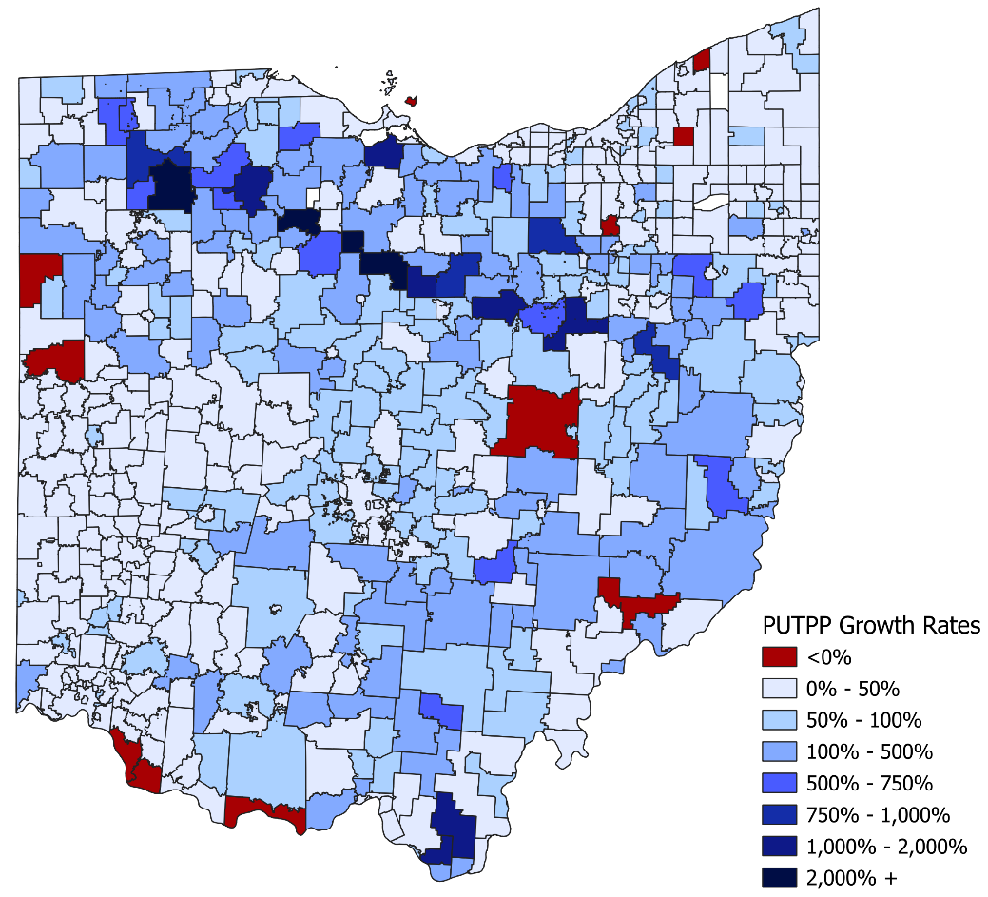
Public utility tangible personal property values have grown rapidly in northern and southeastern regions
Public Utility Tangible Personal Property Value Growth by School District, TY 2017-TY 2022
PUTPP values grew rapidly from 2017 to 2022, increasing 79.0% statewide.
This value grew fastest in school districts in northern and southeastern Ohio affected by the completion of the Rover Pipeline, which carries natural gas from shale production areas to markets in the U.S. and Canada.
Districts with the largest growth (shaded in darker blues in the adjacent map) are generally located along the pipeline’s path.
PUTPP values in these districts range from about seven to 39 times their 2017 values. PUTPP values in Mohawk Local Schools (Wyandot County) grew 600% from 2017 to 2022, while Buckeye Central Local School District (Crawford County) grew over 3,800%.
Ten districts lost PUTPP value since 2017 (shaded in red).
Many have coal-fired or nuclear power plants in their territory.
Examples: Manchester Local in Adams County (-66.4%), Felicity-Franklin Local in Clermont County (-36.7%), New Richmond Exempted Village in Clermont County (-26.2%), and Copley-Fairlawn City in Summit County (-25.6%).
Unlike existing real property, taxes on PUTPP value are not affected by tax reduction factors; taxes on this property grow at the same rate as property values grow.
Source: Ohio Department of Taxation

