Slide 1
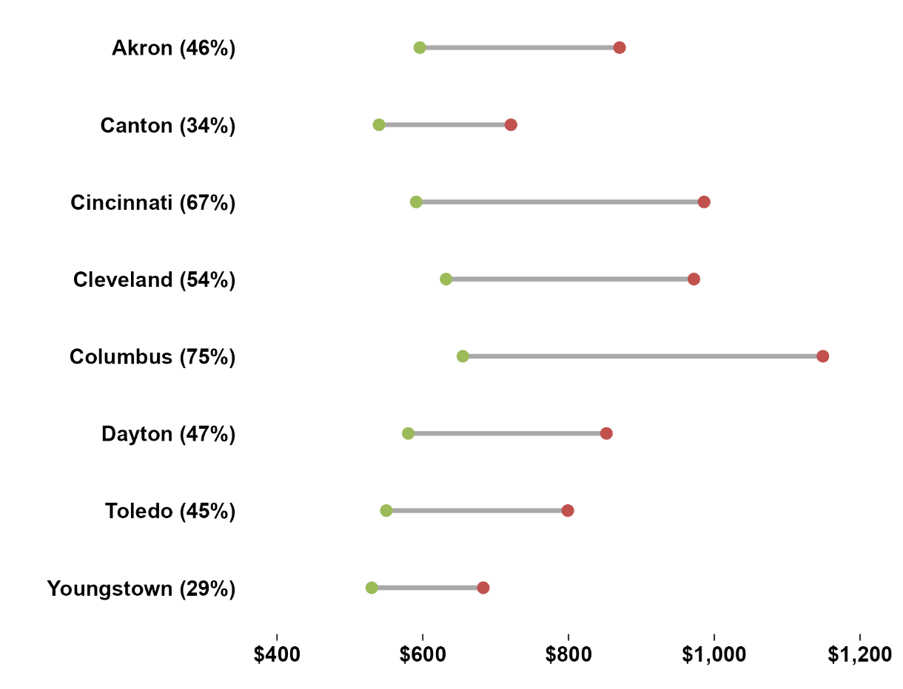
Ohio rents are rising amid a shortage of affordable units
Median Monthly Rent for One Bedroom 2014-2024
The Ohio Housing Finance Agency (OHFA) defines affordable housing to be less than 30% of household income.
According to OHFA, Ohio lacks 270,339 available and affordable units for lower income households. Ohio built 30,936 units in 2022 – primarily driven by multifamily unit production.
Range of Median Monthly Rents in Ohio’s Major Metropolitan Areas
Unit Type | 2024 Monthly Rent | Decade % Change
Studio | $633-$1,046 | 35%-98%
One Bedroom | $683-$1,149 | 29%-75%
Two Bedroom | $860-$1,404 | 31%-65%
Source: U.S. Department of Housing and Urban Development

