Slide 1
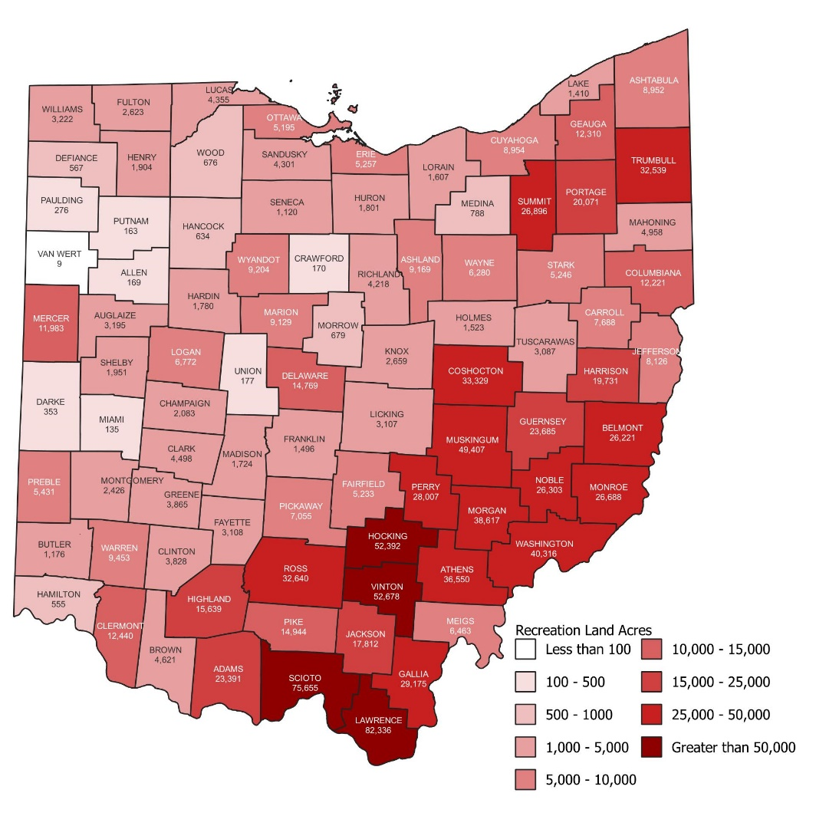
Public recreation lands span nearly 1.1 million acres across Ohio
Public recreation lands including state and national parks, state and national forests, state wildlife areas, and state nature preserves encompass nearly 1.1 million acres:
ODNR-owned or controlled parks, forests, wildlife areas, and preserves – 816,245 acres.
U.S. Forest Service lands (Wayne National Forest) – 244,352 acres.
Cuyahoga Valley National Park and several historical and cultural sites overseen by the National Park Service – 34,751 acres.
Counties with the most state and federal recreation land:
Lawrence (82,336 acres), Scioto (75,655 acres), Vinton (52,678 acres), Hocking (52,392 acres), and Muskingum (49,407 acres).
Counties with the least state and federal recreation land:
Crawford (170 acres), Allen (169 acres), Putnam (163 acres), Miami (135 acres), and Van Wert (9 acres).
Sources: Ohio Department of Natural Resources (ODNR); U.S. National Park Service; U.S. National Forest Service

