Slide 1
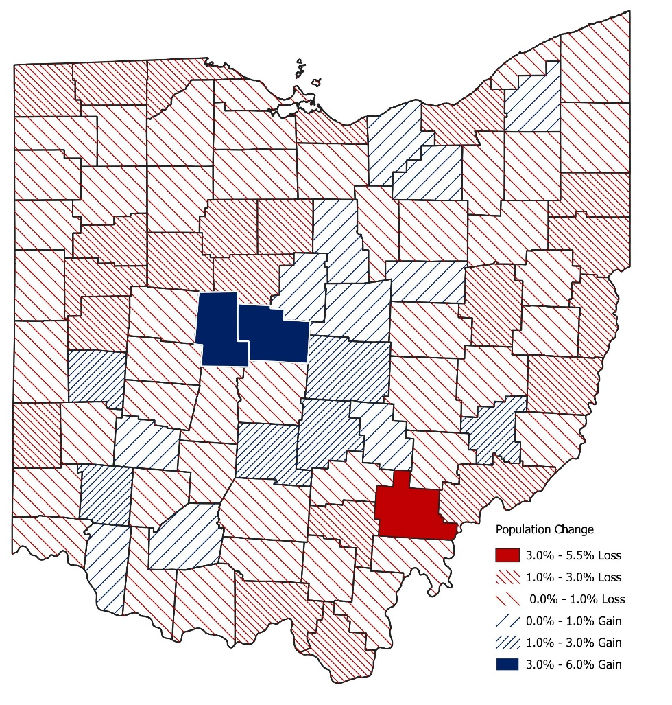
Ohio’s population fell slightly between 2020 and 2022
Ohio’s Population Growth by County, 2020-2022
The statewide population fell by 42,234 (-0.36%) between 2020 and 2022. The national population growth rate was 0.53% between these years.
Ohio’s population was 11,756,058 in 2022.
Ohio ranked 43rd nationally in population growth rate.
Twenty counties gained in population between 2020 and 2022. The average population gain in these counties was 1.4%, with a total population gain of 37,844.
Delaware County saw population growth of 5.2%, gaining 11,130 people, the largest total gain in the state.
Union County experienced the largest percentage gain of 6.0% (3,813).
Sixty-eight counties saw a loss in population between 2020 and 2022. The average rate of loss in these counties was 0.8%, with a total population loss of 80,078.
Athens County lost 5.5% of its population between these years, or 3,414 people.
Cuyahoga County experienced the largest total population loss of 26,532 (2.1%).
Sources: U.S. Census Bureau;
Ohio Department of Development

