Slide 1
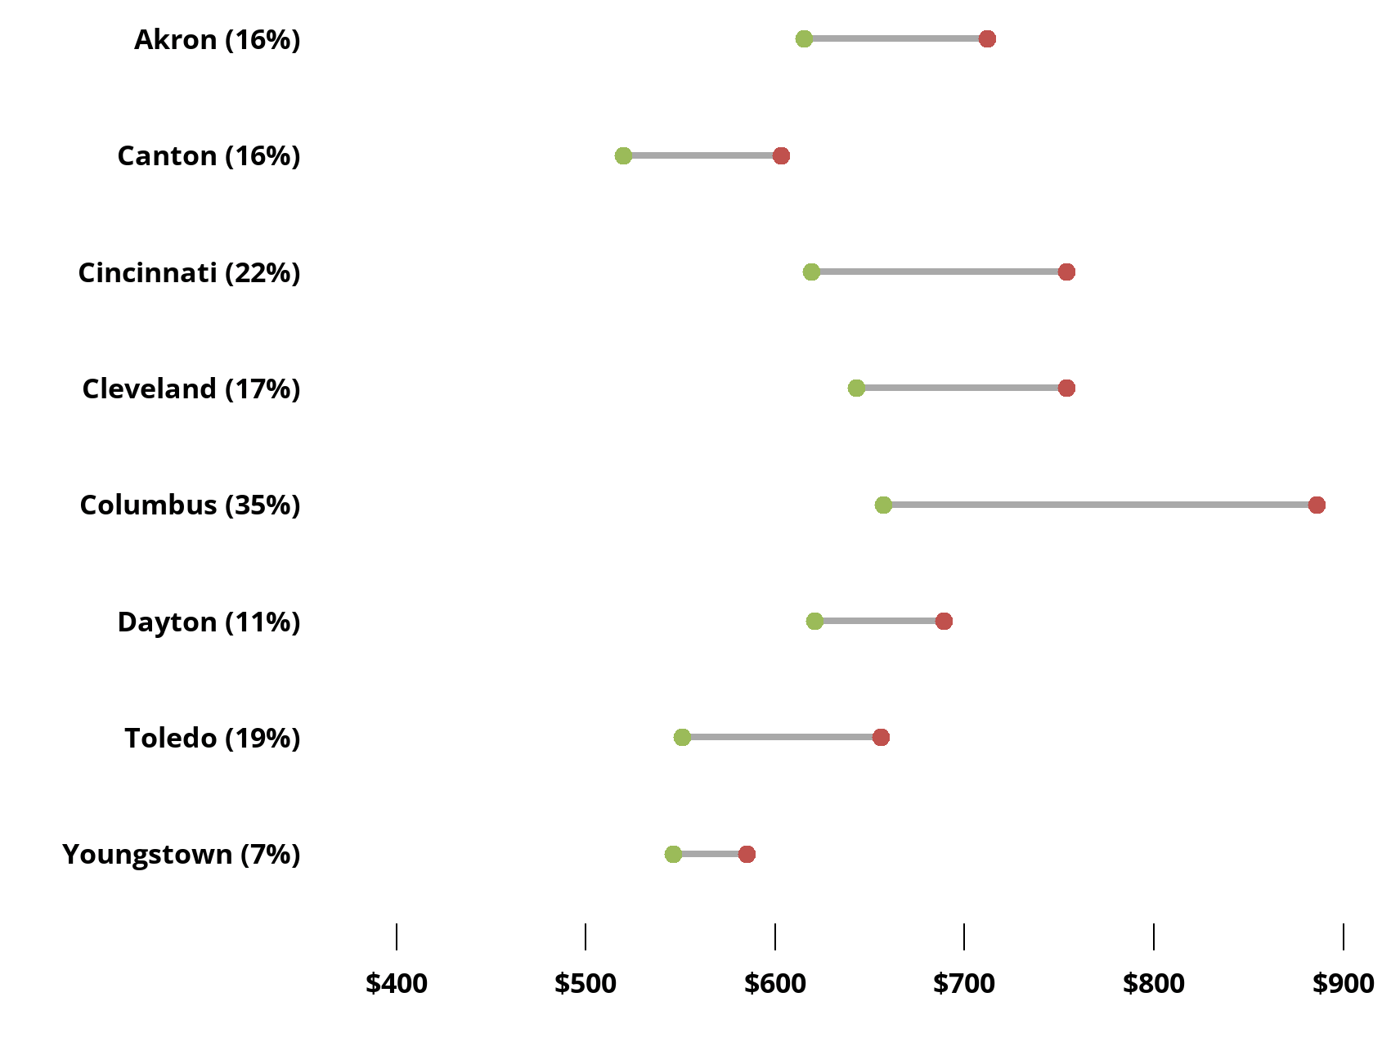
Ohio rents are rising amid a shortage of affordable units
Median Monthly Rent for One Bedroom 2011-2021
The Ohio Housing Finance Agency (OHFA) defines affordable housing to be less than 30% of household income.
According to OHFA, Ohio lacks 256,875 available and affordable units for lower income households. Ohio currently builds 5,000 units annually.
Range of Median Monthly Rents in Ohio’s Major Metropolitan Areas
Unit Type | 2021 Monthly Rent | Decade % Change
Studio | $511-$768 | 4%-35%
One Bedroom | $585-$886 | 7%-35%
Two Bedroom | $734-$1,105 | 10%-34%
Source: U.S. Department of Housing and Urban Development

